Slide 1

Wine Spectator
Data science presentation

Slide 2
Objective
Is there a perceptible increase in quality with an increase in price?
Is there significant difference in the mean price and points among top 10 countries?
Which state in US produces the best wine?

Slide 3
Agenda
raw data
Data cleanup
Data exploration
Data analysis
User inputs
Scope for future analysis

Slide 4
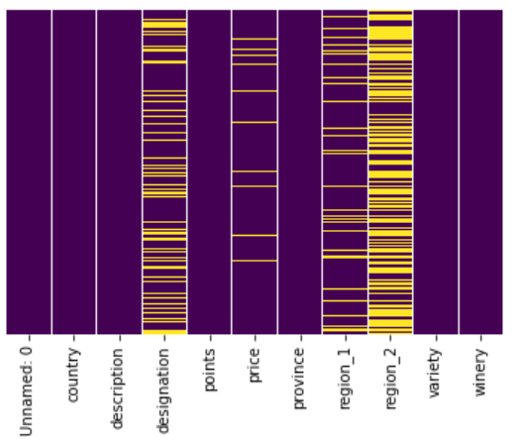
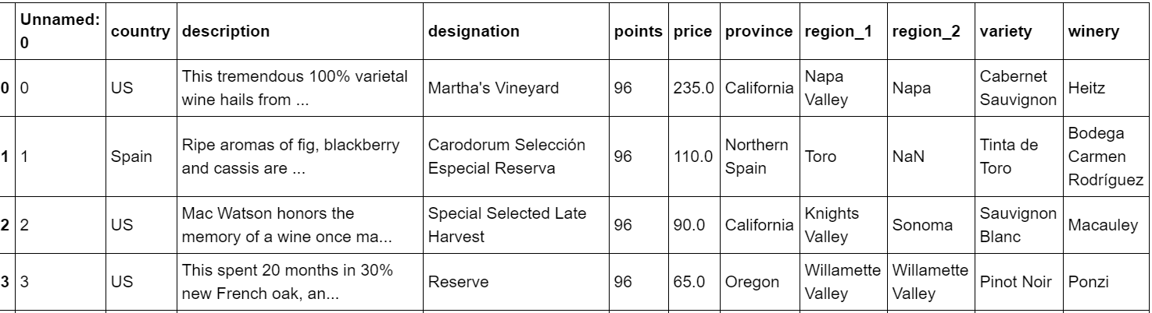
raw data
CSV file with150K records

Slide 5
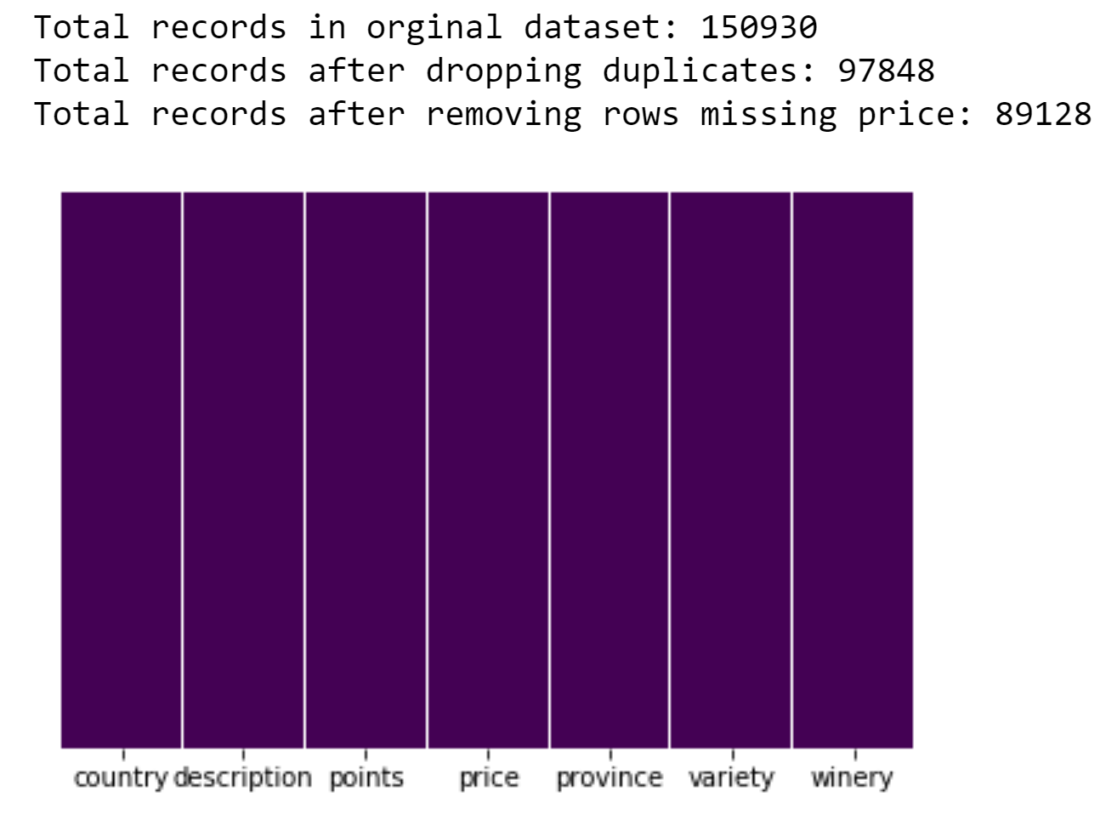
Data cleanup

Slide 6
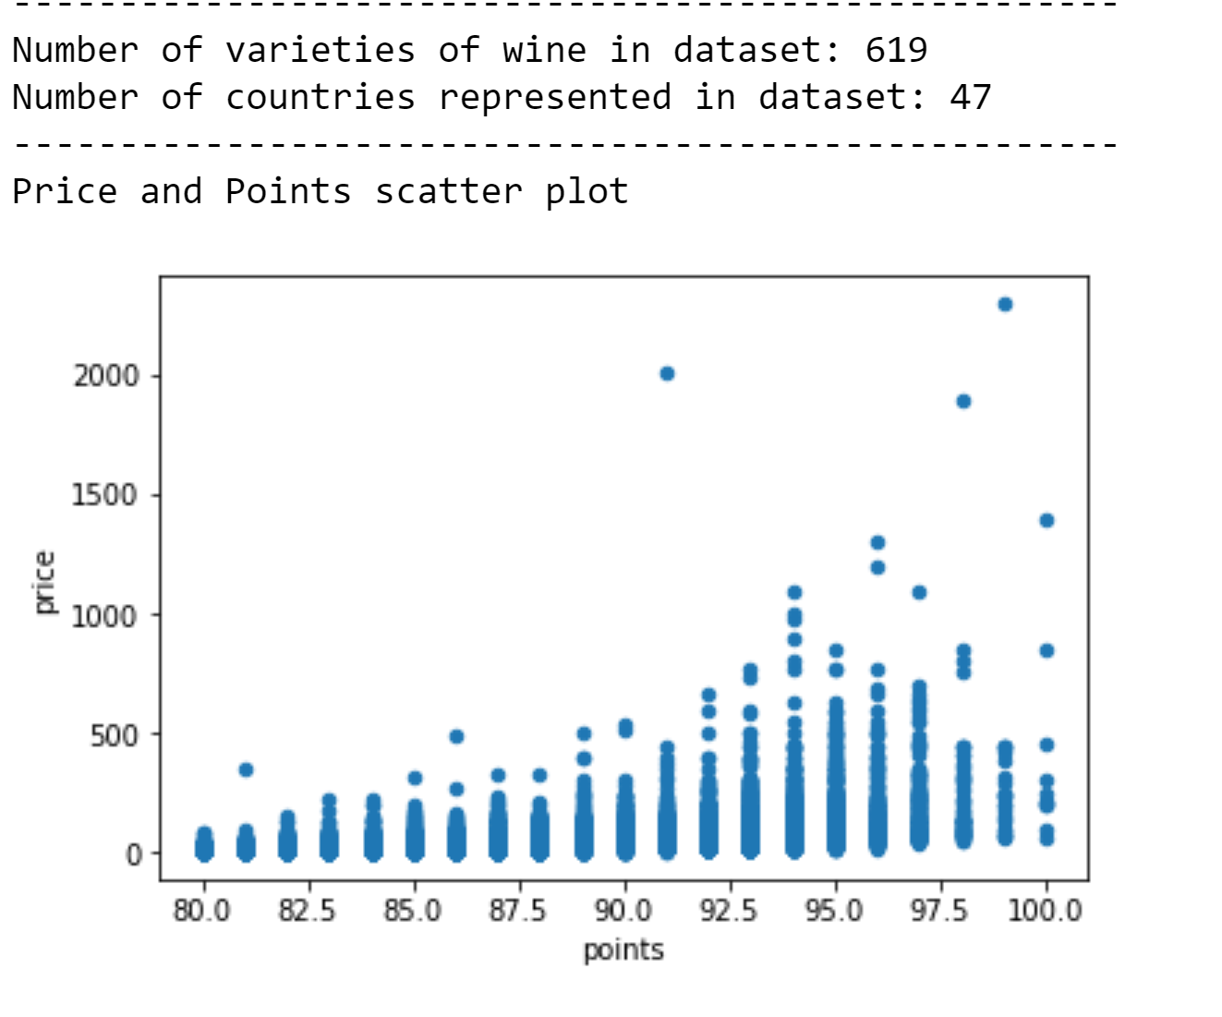
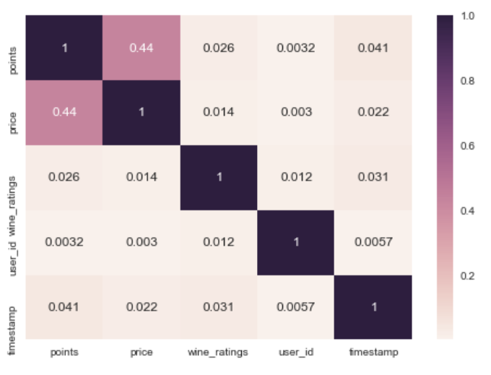
Data Exploration

Slide 7
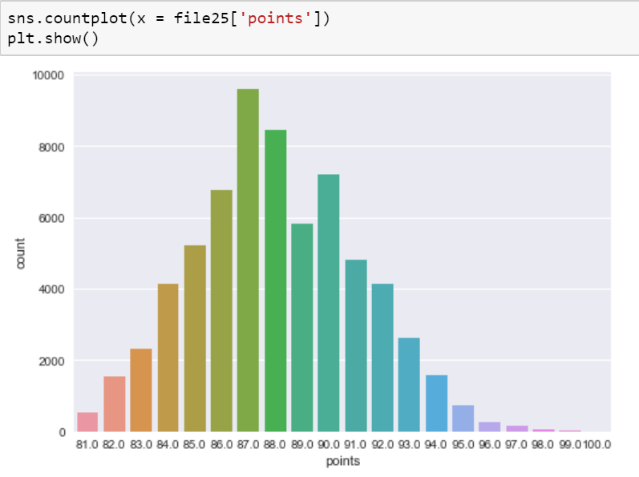
Countplot – wine points

Slide 8
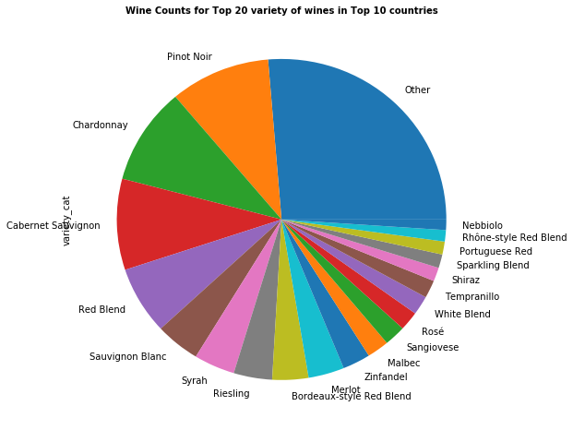
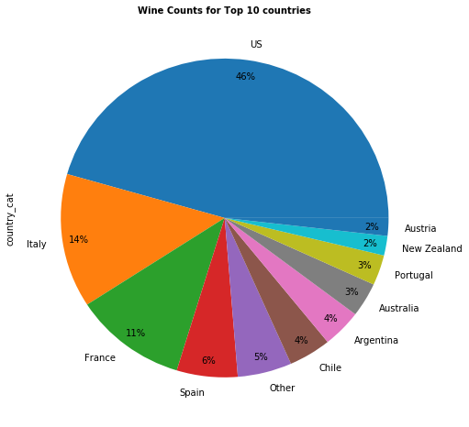
Top 10 countries & Top 20 Varieties

Slide 9
Data Analysis
Is there a perceptible increase in quality with an increase in price?
Is there significant difference in the mean price and points among top 10 countries?
Which state in US produces the best wine?

Slide 10
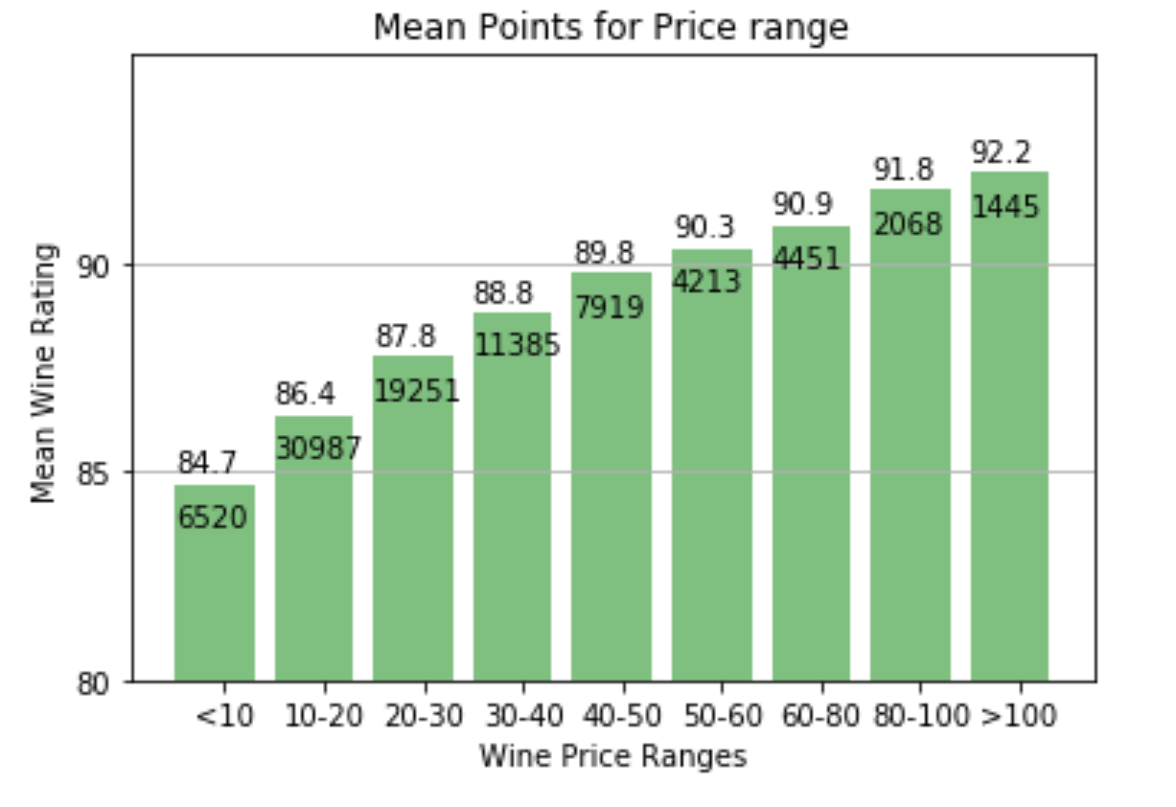
Is there Perceptible increase in Quality with increase in price?

Slide 11
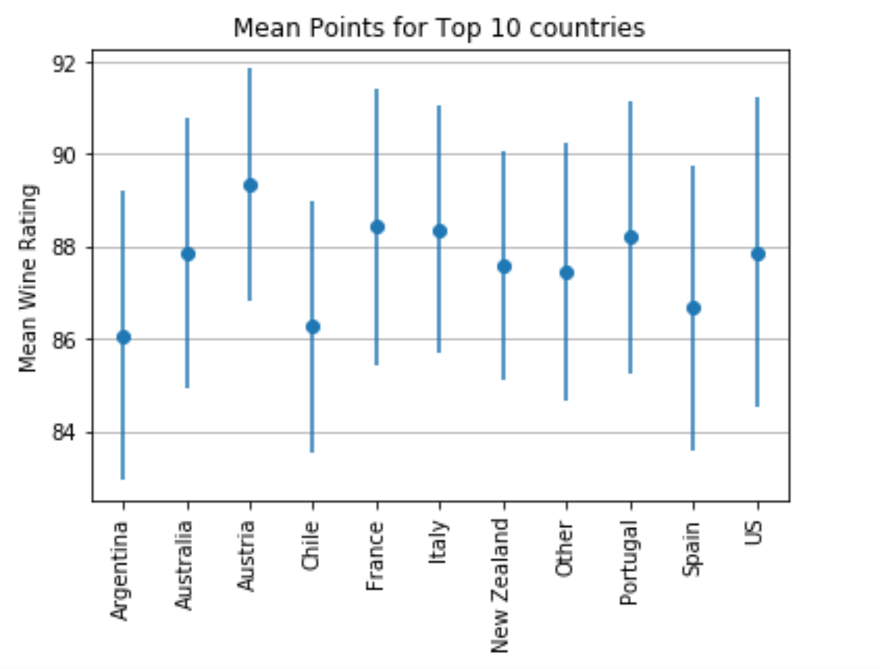
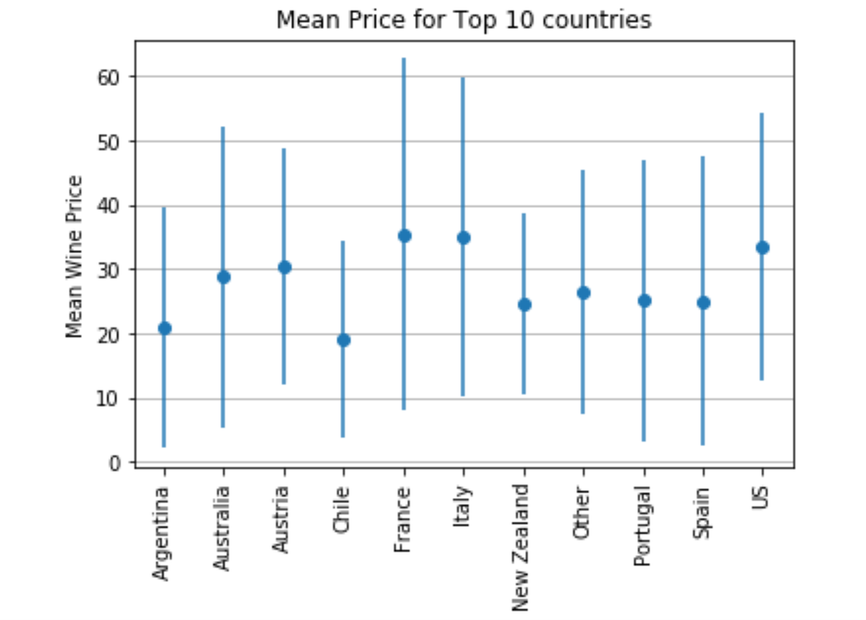
2) Is there a significant difference in mean price and points Among top 10 countries

Slide 12
Which State in US produces the best Wine?
Any Guesses???

Slide 13
Heat Map of Wine Quality across US states
https://plot.ly/~vivekm03/0

Slide 14
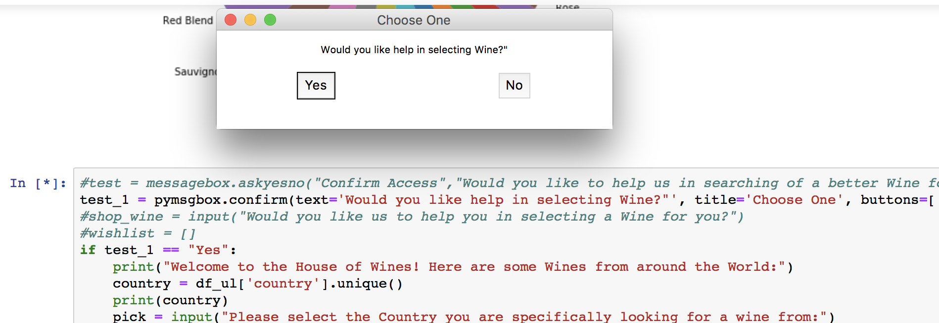
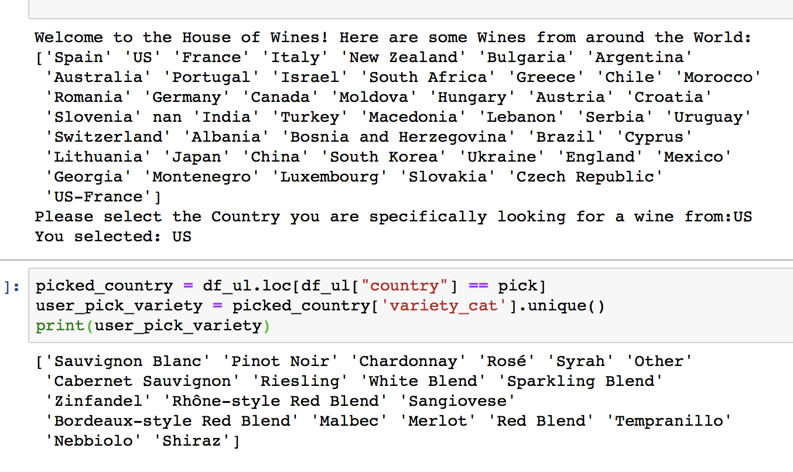
User Interface
Check if the user needs help selecting wine
Filter variety by country

Slide 15
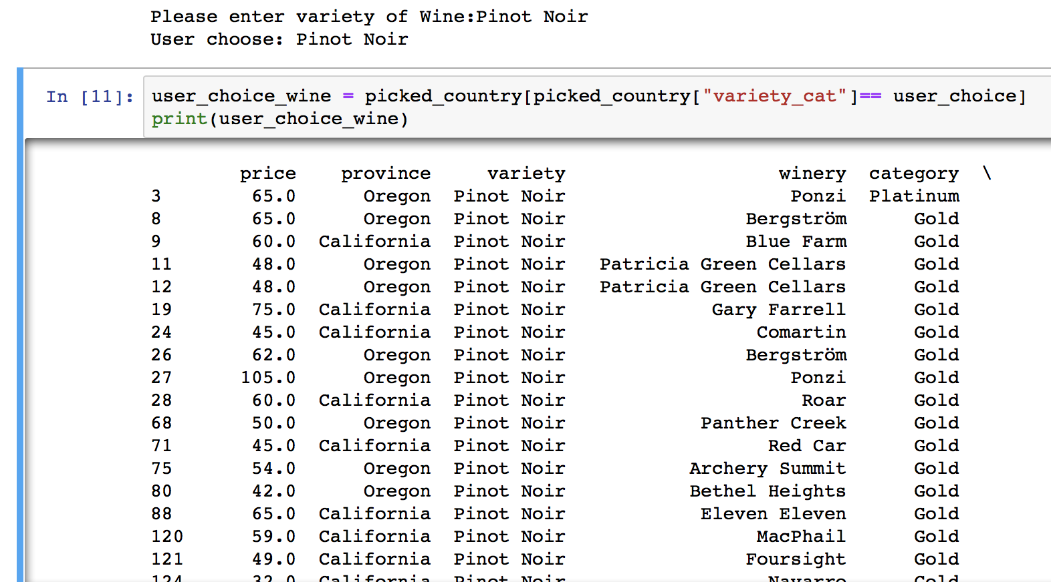
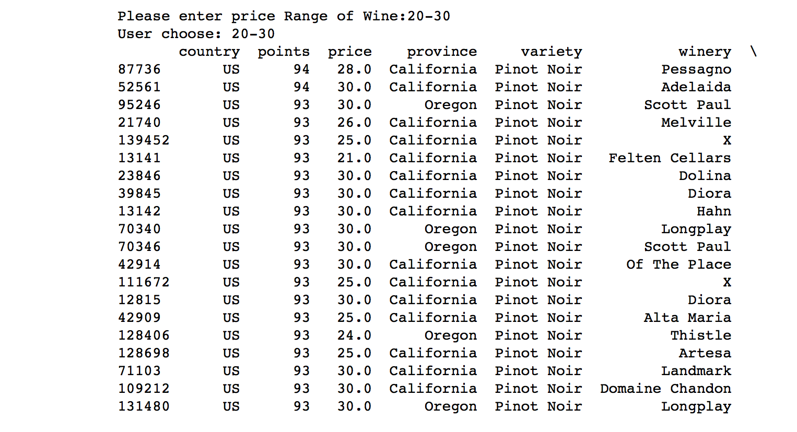
User Inputs
Filter further by price range & points
Filter by Variety

Slide 16
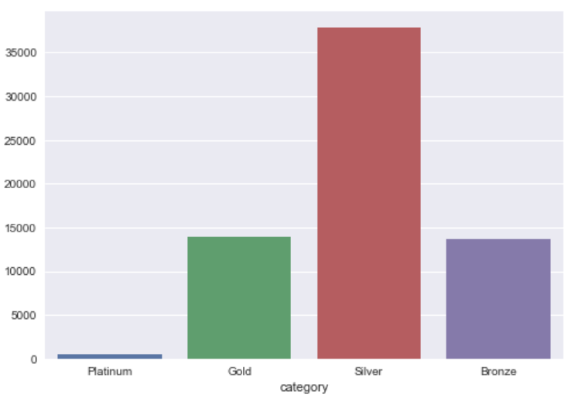
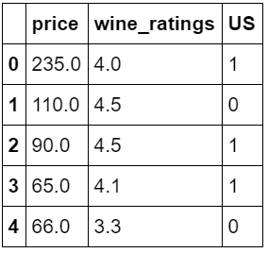
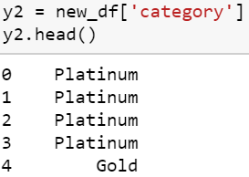
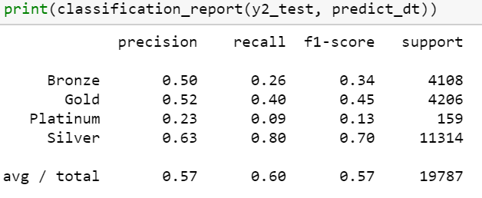
Future Analysis
Using SVM to predict the category of wines
X =
y =
Classification Report

Slide 17
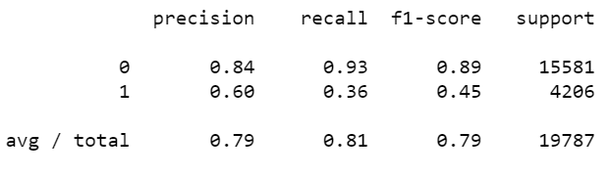
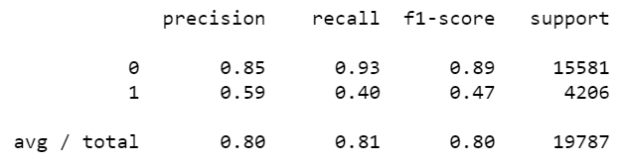
Predicting Country
Using SVM to predict the if the wine is from US
Model performance slightly improves with Grid Search

Slide 18
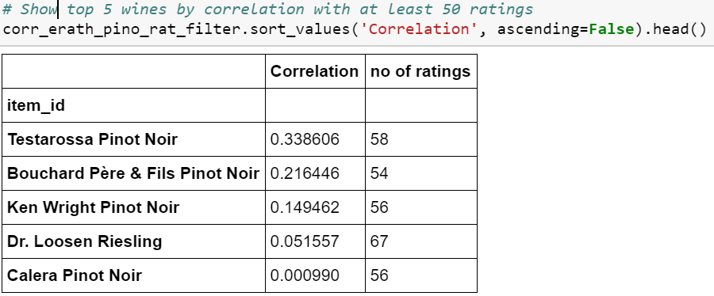
USER Rating Based Recommender

Slide 19


